Slide 1
COMPUTER ORGANIZATION AND ARCHITECTURE
Dr. Rizwan Khan
Head – Department of Computer Science and Engineering
(An NBA Accredited Program)
ABES Institute of Technology, Ghaziabad

Slide 2
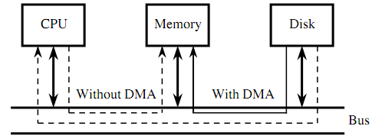
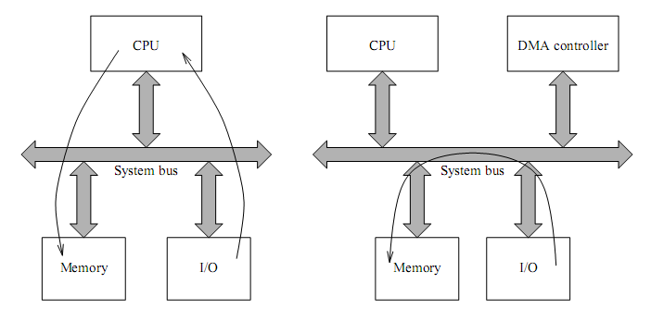
Direct Memory Access

Slide 3
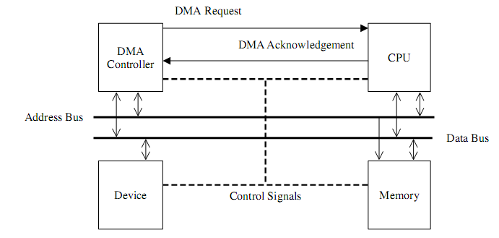
Direct Memory Access
The DMA controller is a piece of hardware that controls one or more peripheral devices. It allows devices to transfer data to or from the system’s memory without the help of the processor. In a typical DMA transfer, some event notiﬁes the DMA controller that data needs to be transferred to or from memory. Both the DMA and CPU use memory bus and only one or the other can use the memory at the same time. The DMA controller then sends a request to the CPU asking its permission to use the bus. The CPU returns an acknowledgment to the DMA controller granting it bus access. The DMA can now take control of the bus to independently conduct memory transfer. When the transfer is complete the DMA relinquishes its control of the bus to the CPU.

Slide 4
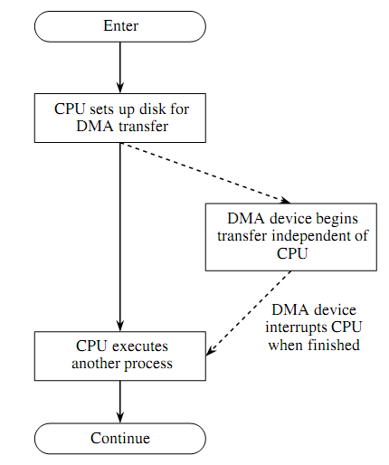
Direct Memory Access

Slide 5
Typical DMA Operation
The processor initiates the DMA controller by identifying the I/O device and supplying the memory address, byte count, and type of operation (input or output). This is referred to as channel initialization. Once initialized, the channel is ready for data transfer between the associated I/O device and memory.
When the I/O device is ready to transfer data, it informs the DMA controller. The DMA controller starts the transfer operation. This step consists of the following substeps.
Obtain the bus by going through the bus arbitration process
Place the memory address and generate the appropriate read and write control signals;
Complete the transfer and release the bus for use by the processor or other DMA devices;
Update the memory address and count value;
If more bytes are to be transferred, repeat the loop from Step (a).
After completing the operation, the processor is notiﬁed. This notiﬁcation is done by an interrupt mechanism. The processor can then check the status of the transfer (i.e., successful or failure).

Slide 6


